Slide 1

The Semantic Web
By Conrad Williams

Slide 2
Contents
What is the Semantic Web?
Technologies
  XML
  RDF
  OWL
Implementations
  Social Networking
  Scholarly Databases
  Medicine
Criticisms

Slide 3

What is the Semantic Web?
According to the W3C, "the Semantic Web is a web of data" (Herman)
Provides a machine-readable version of the data stored on the World Wide Web
Allows this data to be “meshed” together in the same way the World Wide Web forms a web of documents.

Slide 4
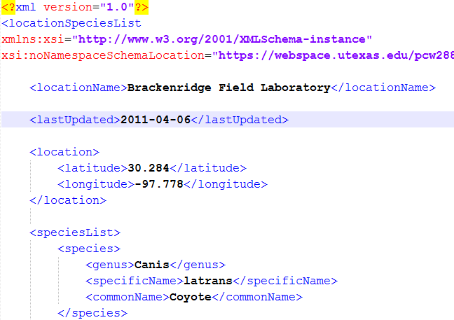
Technologies: XML
Extensible Markup Language (XML)
Allows users to create their own, meaningful tags
  ex. <span>
  vs. <author>
RSS, several APIs

Slide 5
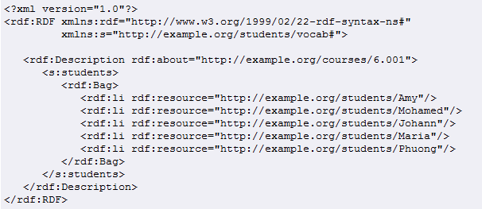
Technologies: RDF
Resource Description Format (RDF)
Usually implemented through XML or through attributes in XHTML (RDFa)
Information stored as ‘triples’ containing a subject, a predicate, and an object
http://www.w3.org/TR/2004/REC-rdf-primer-20040210/

Slide 6
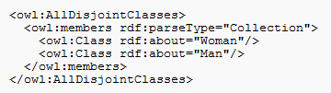
Technologies: OWL
Web Ontology Language (OWL)
  “…an ontology is a formal representation of knowledge as a set of concepts within a domain, and the relationships between those concepts.”
  -Wikipedia
Also based on triples, but allows for an even more detailed description of the relationships between elements
  E.g. ‘SymmetricProperty’
http://www.w3.org/TR/2009/REC-owl2-primer-20091027/

Slide 7
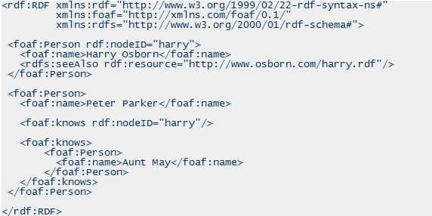

Implementations: Social Networking
Friend of a Friend (FOAF) allows for descriptions of people, their interests, their friends, and the links between all of them to be stored in a machine-readable, portable format that can be extended, merged, and re-used (FOAF project)
"It's not the Social Network Sites that are interesting -- it is the Social Network itself. The Social Graph. The way I am connected, not the way my Web pages are connected"
-(Berners-Lee).
http://www.xml.com/pub/a/2004/02/04/foaf.html

Slide 8
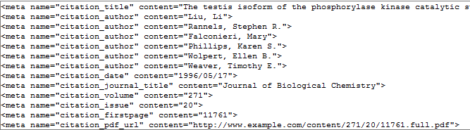
Implementations: Scholarly Databases
Google Scholar actually reads in data about the papers it indexes via properties stored in the <meta> tag in XHTML
  Similar to RDFa
http://scholar.google.com/intl/en/scholar/inclusion.html

Slide 9
Implementations: Medicine
The University of Texas School of Health Information Sciences developed a prototype system called Situation Awareness and Preparedness for Public Health Incidents using Reasoning Engines (SAPPHIRE)
  integrates data from many different sources and pieces them together to form constructs that are useful in environmental protection and environmental epidemiology in addition to public health

Slide 10
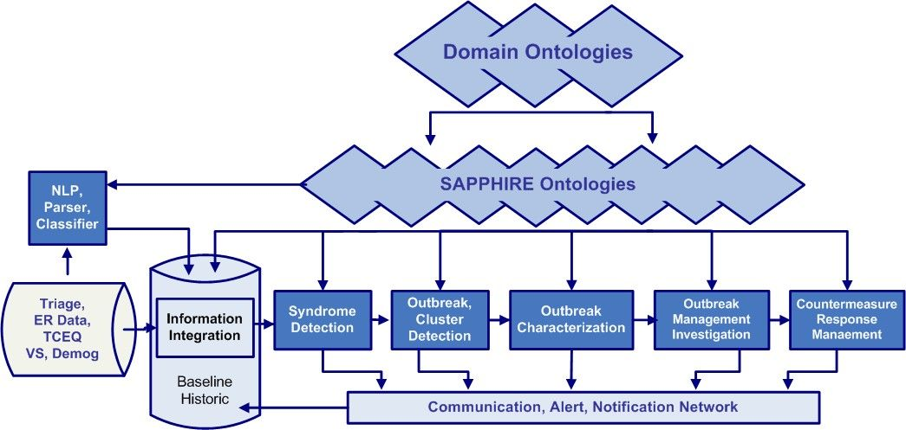
Implementations: Medicine
SAPPHIRE can even be quickly reconfigured to take in real-time data from new sources
  Within eight hours of shelters opening after hurricane Katrina, SAPPHIRE was extended to also include information from just-in-time PDA based questionnaire
http://www.w3.org/2001/sw/sweo/public/UseCases/UniTexas/

Slide 11
Criticisms
You can get all of the benefits without the complexity of ontologies and the like, and you have to agree on how data is stored.
  Potential Solutions:
    Thesauri
    Use programs to help construct and use ontologies
      E.g. Jena, a framework for Java that works with RDF and OWL data

Slide 12
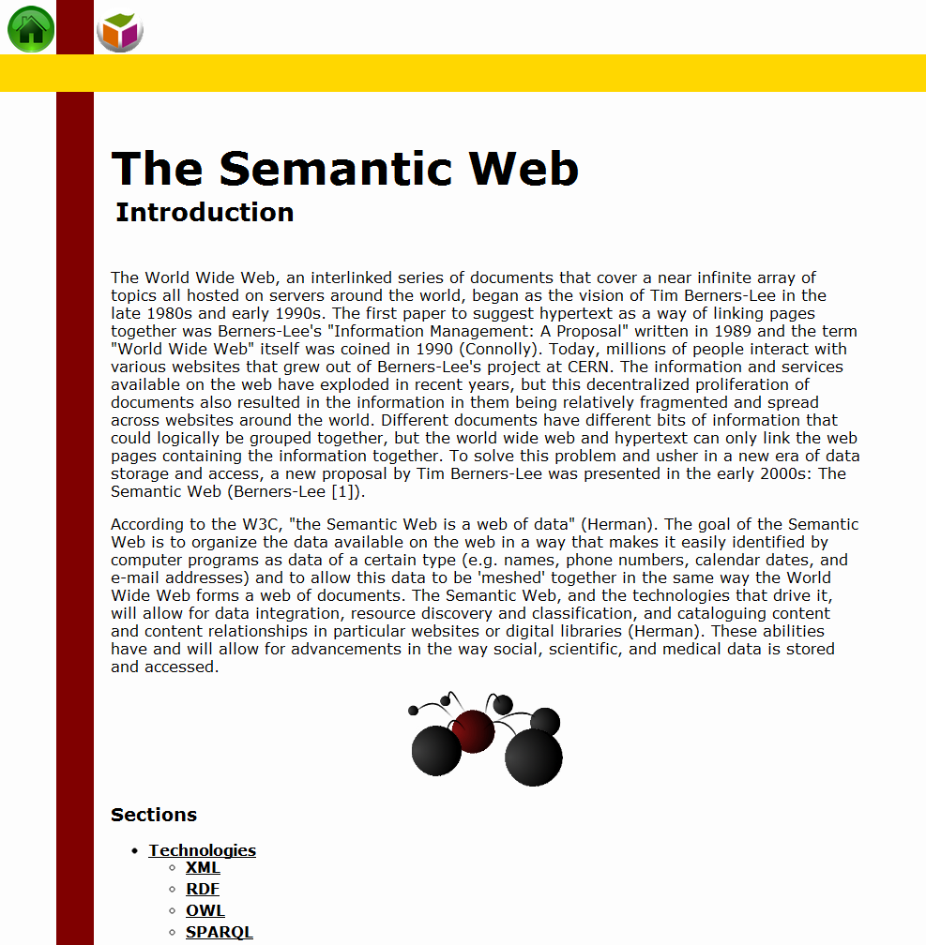
Questions?
Also, please go to the website:
https://webspace.utexas.edu/pcw288/www/semantic/

